Slide 1
PGVCL Training
Day-10

Slide 2
Flutter Training for PGVCL Department
Day 10 : Advanced Topics

Slide 3
Overview
Topics We’ll Be Covering For Today
Theory
Reducing app size
Clean Architecture(SOLID,MVVM)
Debugging with dart dev tools
Practical
Refactor a previous project to follow clean architecture principles.
Assignment
Debug an app using Dart DevTools and provide a performance improvement report.

Slide 4
Objectives
Learn techniques to reduce app size for better performance.
Understand the principles of clean architecture (SOLID, MVVM).
Explore advanced debugging with Dart DevTools.
Apply clean architecture principles to a real-world project.

Slide 5
Reducing App Size
Why Reduce App Size?
Faster downloads and updates.
Improved performance and user experience.
Better compatibility with low-storage devices.
Techniques to Reduce App Size:
Code Optimization:
Remove unused code and dependencies.
Use flutter pub deps --analyze-size to identify large dependencies.

Slide 6
Asset Optimization:
Compress images using tools like TinyPNG.
Use vector graphics (e.g., SVG) where possible.
Build Configuration:
Use split APKs or App Bundles for Android.
Enable ProGuard or R8 for code shrinking.
Flutter Features:
Use deferred loading for large resources.
Avoid overusing packages for minor features.

Slide 7
Clean Architecture Overview
What Is Clean Architecture?
A design pattern ensuring maintainable, scalable, and testable codebases.
Key Principles:
SOLID Principles:
Single Responsibility, Open/Closed, Liskov Substitution, Interface Segregation, Dependency Inversion.

Slide 8
Clean Architecture Overview
2. MVVM (Model-View-ViewModel):
Model: Handles business logic and data.
View: Represents the UI.
ViewModel: Connects Model and View, exposing data streams.

Slide 9
Benefits of Clean Architecture
Improved Maintainability: Code is modular and easier to update.
Scalability: Supports the addition of new features without impacting existing ones.
Testability: Easier to write unit and integration tests.
Team Collaboration: Facilitates work on different modules simultaneously.

Slide 10
Debugging with Dart DevTools
What Are Dart DevTools?
A suite of debugging and performance tools for Flutter and Dart.
Key Features:
Widget Inspector: Visualize and debug the widget tree.
Performance View: Analyze app performance and frame rendering.
Memory View: Track memory usage and leaks.
Logging Console: Inspect logs and error messages.
Network Debugging: Monitor API calls and responses.

Slide 11
Practical: Refactor a Project to Use Clean Architecture
Objective: Refactor an existing project to follow clean architecture principles.
Steps:
Organize Project Structure:
Separate code into layers: Data, Domain, Presentation.
Apply SOLID Principles:
Use Dependency Injection for loosely coupled code.
Implement MVVM:
Create Model, ViewModel, and View components.
Test Functionality:
Write unit and integration tests for business logic and UI.

Slide 12
Assignment
Task:
Refactor a previous project (e.g., Todo app or API-based app) to follow clean architecture principles.
Implement:
Dependency Injection using get_it or Provider.
Separate concerns into layers.
Ensure functionality is maintained and tested.

Slide 13
Best Practices for Advanced Topics
Reducing App Size: Continuously monitor and optimize app size during development.
Clean Architecture: Start small, progressively adopting principles in larger projects.
Debugging: Leverage Dart DevTools for regular performance profiling.
Documentation: Maintain clear documentation for architecture and debugging practices.

Slide 14
Conclusion
Reducing app size ensures better performance and user retention.
Clean architecture is vital for creating scalable and maintainable apps.
Dart DevTools empower developers to debug and optimize effectively.
Applying these practices elevates the quality of Flutter applications.

Slide 15
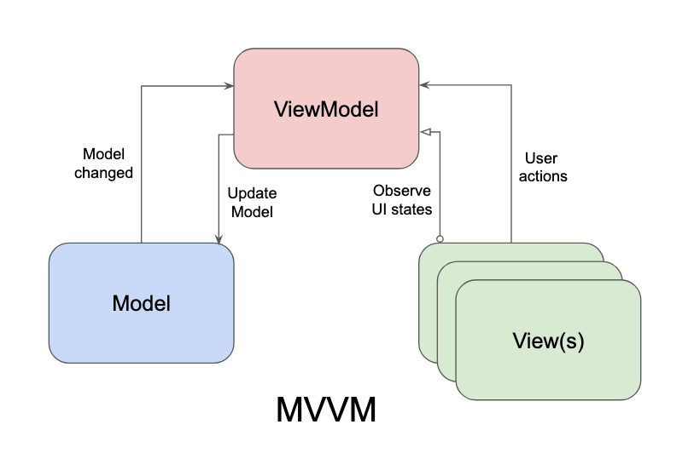

Slide 16
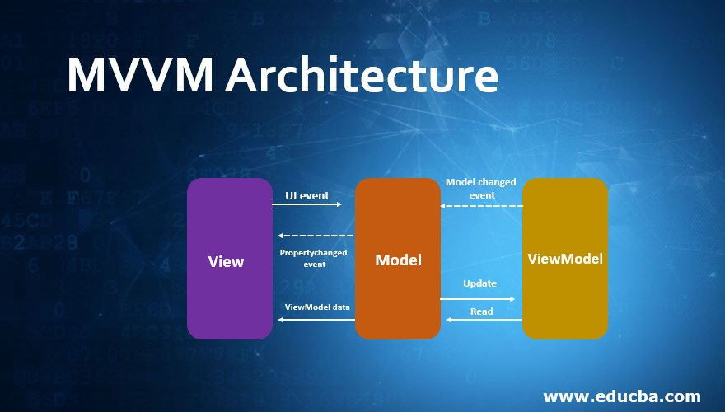

Slide 17
Practical Example
Link
Assignment Example
Create a basic UI with 3 Stateless Widgets and 2 Stateful Widgets

